Slide 1

Deploying Machine Learning Models with FastAPI
Bridging the Gap from Model to Production
AI Engineering Internship Assignment
BY KRITIKA RAJ

Slide 2
What is FastAPI & Why AI Engineers Love It?
What is FastAPI?
A modern, fast (high-performance) web framework for building APIs with Python 3.7+.
Based on standard Python type hints.
Built on Starlette (for web parts) and Pydantic (for data parts).
Why is it Great for AI/ML?
Speed
Easy APIs
Automatic Docs
Data Validation
Asynchronous Support
Analogy

Slide 3
The ML Model Deployment Challenge
The Problem: I hvae trained a brilliant Machine Learning model. Now what?
The Solution: Web APIs (Application Programming Interfaces)
An API defines how different software components should interact.
Our Workflow (High-Level):
Train & Save the ML Model.
Build a FastAPI Application that loads the model.
Run the FastAPI Application as a web service.
Client makes API request -> Gets prediction!

Slide 4
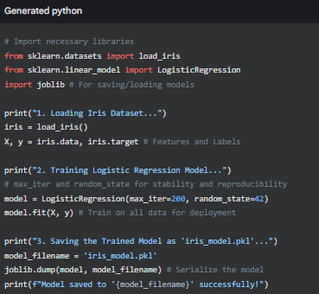
Step 1: Train & Save Your ML Model (The "Chef")
Goal: Create a trained ML model and save it for future use.
Our Project Example: Iris Species Prediction
Dataset: Iris flower dataset (features: sepal length/width, petal length/width; target: species type - Setosa, Versicolor, Virginica).
Model: A simple classification model, like Logistic Regression.
Result: A iris_model.pkl file, which is our trained model ready to be loaded by FastAPI.

Slide 5
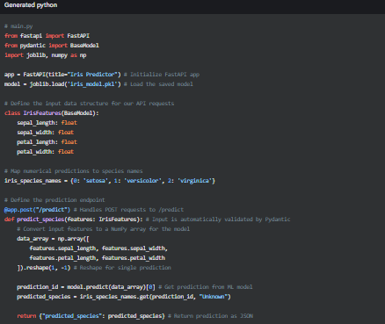
Step 2: Building the FastAPI Application (main.py)
Goal: Create a Python script (main.py) that loads our iris_model.pkl and exposes a prediction endpoint.
Key Components:
FastAPI instance: The main application object.
Model Loading: Code to load iris_model.pkl when the app starts.
Pydantic BaseModel: Defines the expected input data structure and types, enabling automatic validation.
@app.post("/predict") endpoint: The function that handles incoming prediction requests.
Code Snippet (Key Parts of main.py):

Slide 6
Step 3: Running & Testing Our API
Running the FastAPI App:
Open your terminal in the same directory as main.py and iris_model.pkl.
Ensure fastapi, uvicorn, and scikit-learn are installed (pip install fastapi uvicorn scikit-learn).
Execute: uvicorn main:app --reload
main: refers to your main.py file.
app: refers to the app = FastAPI() instance inside main.py.
--reload: (for development) automatically restarts the server on code changes.
Testing with Interactive Docs (Swagger UI):
Once Uvicorn is running, open your web browser to: http://127.0.0.1:8001/docs
FastAPI automatically generates comprehensive documentation and an interactive interface to test your API.
[Include a small screenshot of the Swagger UI with the /predict endpoint expanded, if possible for your video/presentation]
Example API Request (JSON Payload):
Method: POST
URL: http://127.0.0.1:8000/predict
Body (JSON):

Slide 7
Real-World Challenge: Iris Species Identifier
Scenario: A client needs an automated way to identify Iris flower species from measurements.
Our Solution in Action:
We trained a Logistic Regression model on the Iris dataset.
We deployed this model as a FastAPI service with a /predict endpoint.
Now, any application (website, mobile app, data pipeline) can send flower measurements to our API.
The API uses our trained ML model to instantly return the predicted species.
This is the core of AI engineering: making your intelligent models accessible and usable in real applications!

Slide 8
Beyond Basics & Why This Matters
Next Steps in Deployment:
Containerization (Docker): Packaging your app and its dependencies into a single, portable unit for consistent deployment everywhere.
Scalability: How to handle thousands or millions of requests (e.g., using Gunicorn workers, Kubernetes).
Monitoring: Keeping an eye on your API's performance and model's accuracy in production.
Cloud Deployment: Deploying to platforms like AWS, Azure, Google Cloud for robustness and scalability.
Why This Assignment is Crucial:
I have learned a fundamental skill in AI Engineering
Demonstrated coding,
This is how ML models create real value in products and services!

Slide 9
Q&A Feel free to ask questions This project demonstrates the end-to-end deployment of an Iris classification Machine Learning model using the FastAPI framework. It involved training and serializing the model, then building a robust API to serve predictions, providing hands-on experience in productionizing AI solutions
kritikaraj13/Deploying-Machine-Learning-Models-with-FastAPI-

